Slide 1
Chapter 8: Simple Linear Regression
Part 2

Slide 2
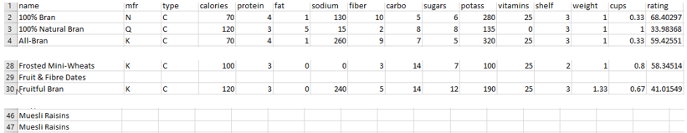
Cereal.csv: Needs Cleaning
First, I deleted the second row containing data type. Then took a quick look through the data. Deleted rows that were empty of data for a particular cereal.
Imported the data (74 records). Quick check of data using summary command.

Slide 3
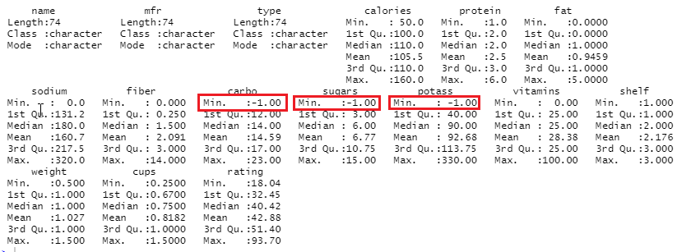
summary(cereal)

Slide 4
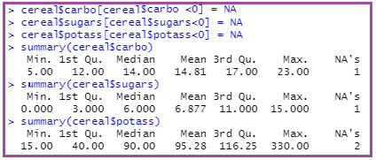
Changing -1s to NAs

Slide 5
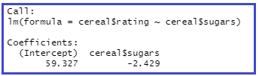
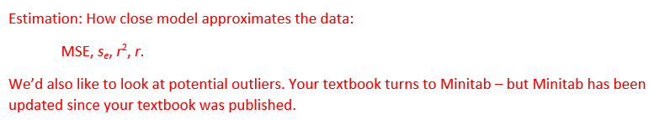
Results of lm command slightly different than for previous PowerPoint lecture.

Slide 6
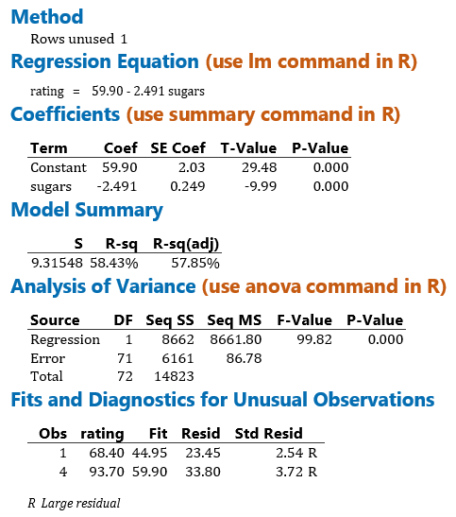
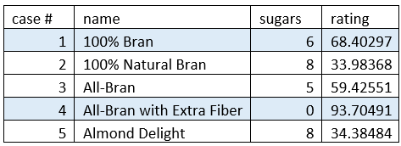
Minitab Output

Slide 7
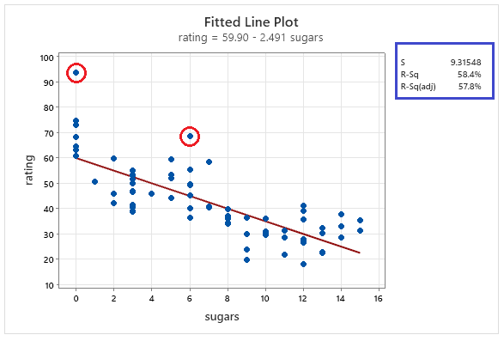
Minitab: Fitted Line Plot

Slide 8
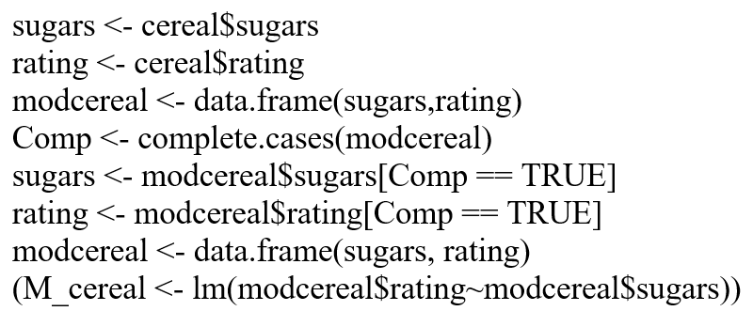
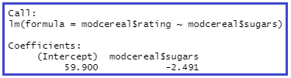
Dataframe with sugars and rating, only complete cases: modcereal

Slide 9
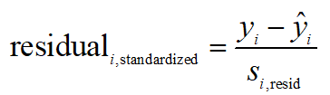

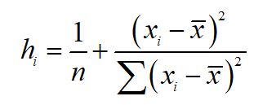

Data values that may exert undue influence on regression results
Outliers
High leverage points
Influential observations
Outlier: large absolute standardized residual (flagged if >2)
(flagged if > 2(m+1)/n),
m = # pred. variables)

Slide 10



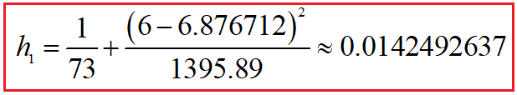






Calculations: leverage, standardized residual for 1st observation

Slide 11
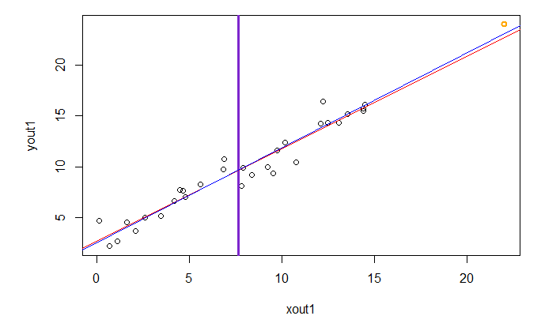

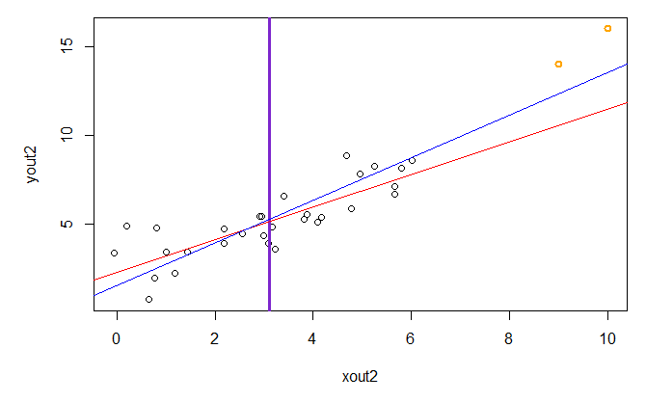

Leverage and Influence

Slide 12
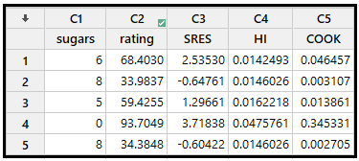



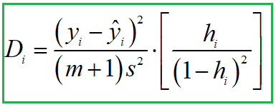
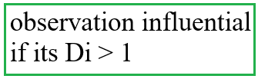
Minitab, R to the Rescue!!!

Slide 13
Inference for Regression
https://www.learner.org/series/against-all-odds-inside-statistics/
Against All Odds: Inside Statistics
Unit 30: Inference for Regression
Population Model:
Assumptions:
Video:

